Slide 1
Power Grid Anomaly Detection
CMPT 318 - Cyber Security
Sajandeep Toor, Steven Xia

Slide 2
Overview
Threat of cyber attacks are increasing
Critical infrastructure such as power grids are under attack
Use Hidden Markov Models to detect anomalies in power grid stream data

Slide 3
Introduction
Advanced Persistent Threats (APTs)
Supervisory Control and Data Acquisition (SCADA)
Hidden Markov Models

Slide 4
Threats to Cybersecurity
Number of threats growing rapidly
Threats themselves are evolving
Rise of IoT devices
Advanced Persistent Threats

Slide 5
Anomaly Detection
What is an anomaly?
Types of anomalies
Point Anomalies
Contextual Anomalies
Collective Anomalies

Slide 6
Use of Hidden Markov Models
Modeling normal behavior
Detecting non-normal behaviour

Slide 7
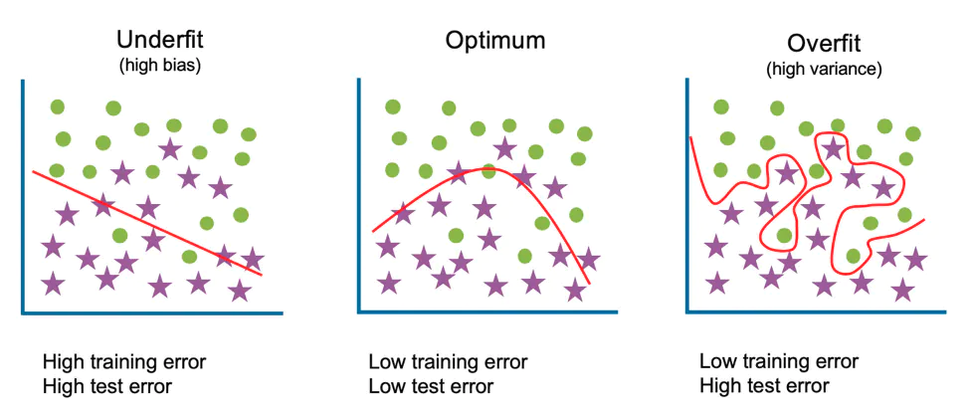
Fitting of a Model
Overfitting
Underfitting
IBM Cloud Education. (2021, March 23). What is underfitting? IBM. Retrieved December 4, 2021, from https://www.ibm.com/cloud/learn/underfitting.

Slide 8
Methodology

Slide 9
Data Analysis
Power grid time series data December 16th, 2006 to December 1th 2009
Features:
Global Active Power
Global Reactive Power
Global Intensity
Voltage
Sub metering 1 - 3

Slide 10
Data Cleaning and Scaling
Problem: Data had a lot of missing values
Solution: Processing and cleaning the data
Linear Interpolation
Scaling
Scaled using standardization

Slide 11
Feature Selection

Slide 12
Feature Selection
Too few features is going to underfitting
Too many features will cause overfitting
Choice: Global_active_power and Global_intensity
Notes:
Too few features unable to properly represent the behaviour of the power grid
Too many features is redundant and has too many measurements so the model can easily overfit
Tried a variety of features from one (Global_intensity) to three (Global_active_power, Global_intensity, Submetering_3)
Two features had the best result, according to training (training methodology discussed later)

Slide 13
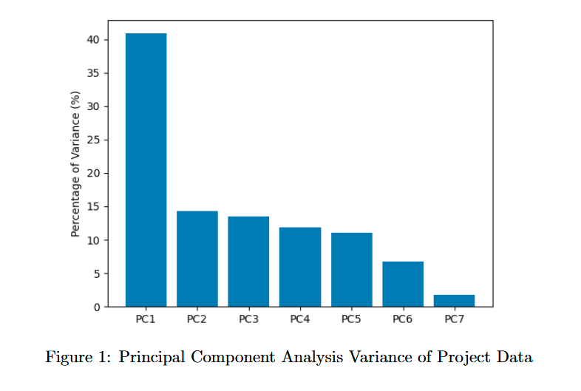
Feature Selection
Notes:
PC1 accounts for approximately 41% of the variance
All the others are low percentage

Slide 14
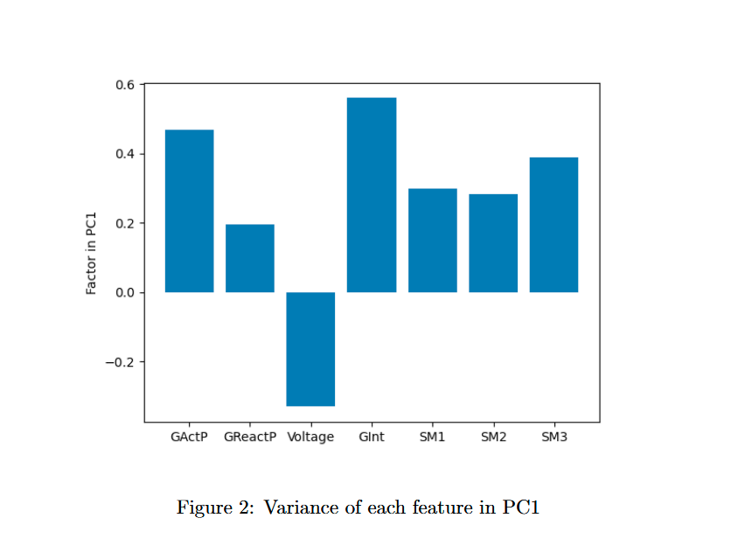
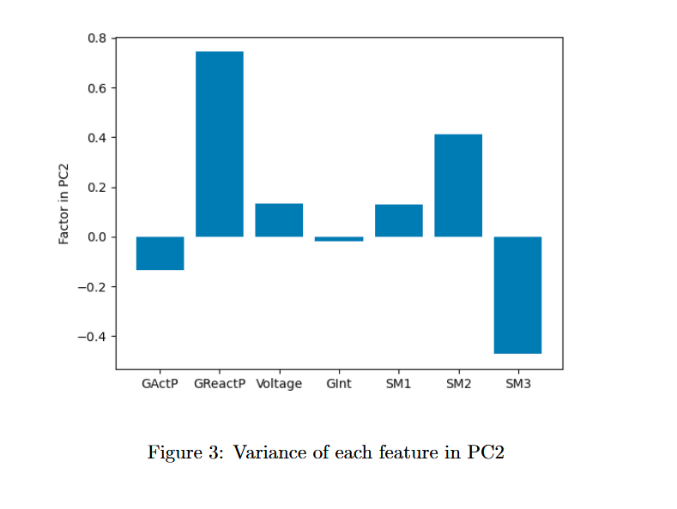
Feature Selection
Notes:
The largest factors of PC1 are Global_intensity, Global_active_power, Submetering_3, and Voltage
As mentioned before, two features worked best
Global_reactive_power was a really big factor of PC2, however, isn’t the entire PC
Maybe if PC2 was only Global_reactive_power then we could have used that as one of our features

Slide 15
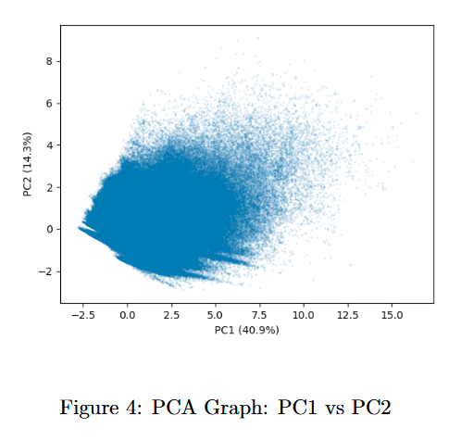
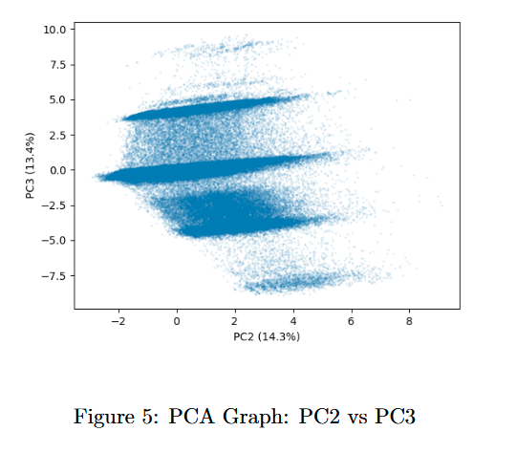
Feature Selection
Notes:
These look cool
See the clumping in PC2 vs PC3, isn’t that cool?
And PC1 vs PC2 looks like a fish facing left, that’s gotta be the peak of coolness

Slide 16
Training Models

Slide 17
Training Models
Use a third of the data for testing
Train 21 models to determine the best number of states
Notes:
Data set originally 3 years; set aside last year for testing
Trained all possible states in range 4–24

Slide 18
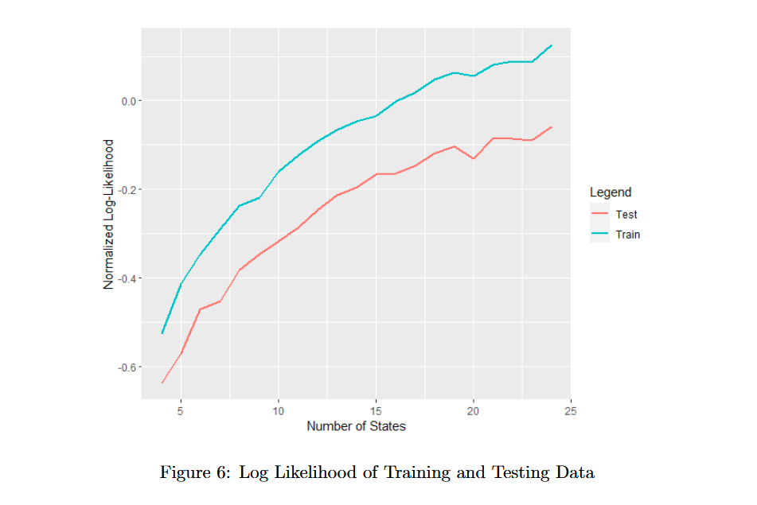
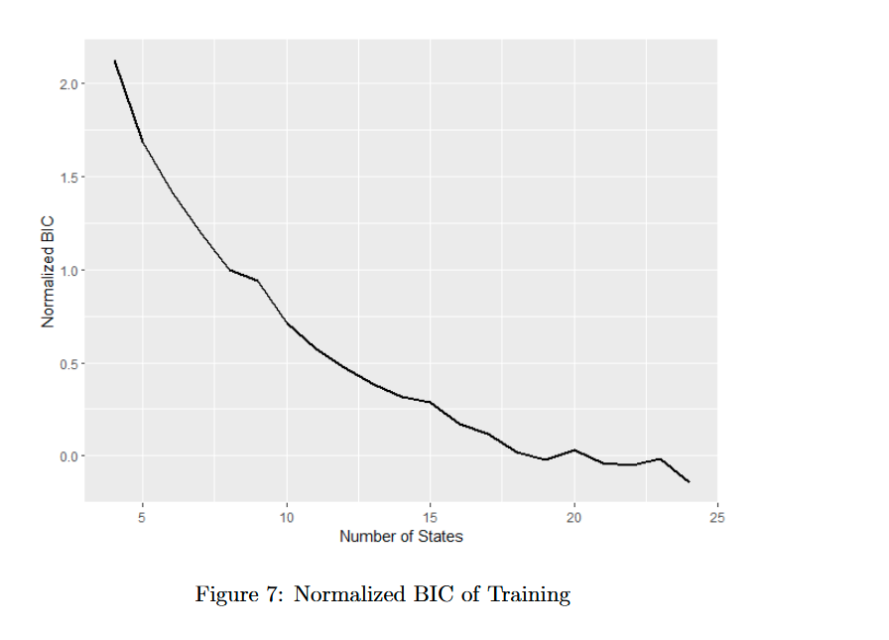
Training Models
Notes:
Test log likelihood continued to follow train log likelihood
Bayesian information criterion decreased
No sign of overfitting

Slide 19
Anomaly Detection

Slide 20
Anomaly Detection
Run the trained model on data with injected anomalies
Choose threshold for detecting anomalies
Depends on properties of false positives to false negatives
Notes:
Use forward backward on trained model for each individual time interval
Get log likelihood of each individual time interval
Script to calculate optimal threshold for anomaly detection (in the attached report :)
Depends on ratio of normal data to anomalous data; high ratio means we should value false positives more
Depends on damage caused by false negatives compared to false positives: high ratio means we should value false negatives more
Script can be easily configured to consider the above factors

Slide 21
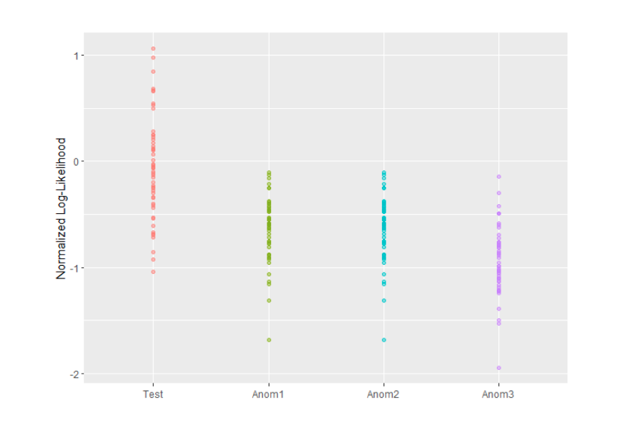
Anomaly Detection
Notes:
Log likelihoods of individual intervals in the test and anomalous data sets
No model is perfect, lots of overlap means sometimes it is not accurate
Means determining threshold is important
Threshold is 0 gives too many false positives
Threshold is –1 gives too many false negatives
Script says threshold –0.342 is optimal for unit ratio of false positives to false negatives

Slide 22
Point Anomaly Detection
Used a different approach than HMMs
Took the average of each minute of each feature in the interval
This represents normal behaviour of the power grid for the interval
Find thresholds using testing data
Results:
Anomaly Dataset 1: 47
Anomaly Dataset 2: 47
Anomaly Dataset 3: 2,530

Slide 23
Conclusion

Slide 24
Accomplishments
An HMM that represents normal behavior in power grids
Can be used to find anomalies
Adjustment of log-likelihood thresholds for anomalies
For threshold –0.342, we get 25.5% of normal data as false positive and 9.3% of anomalous data as false negative.

Slide 25
Challenges
Substantial amount of overlap between the log-likelihoods of individual intervals from the testing data set and the anomaly data set

Slide 26
Lessons Learned
Feature selection is important!
How we split the dataset into training and testing is also important!

Slide 27
Thank you for listening!
Any questions?

Slide 28
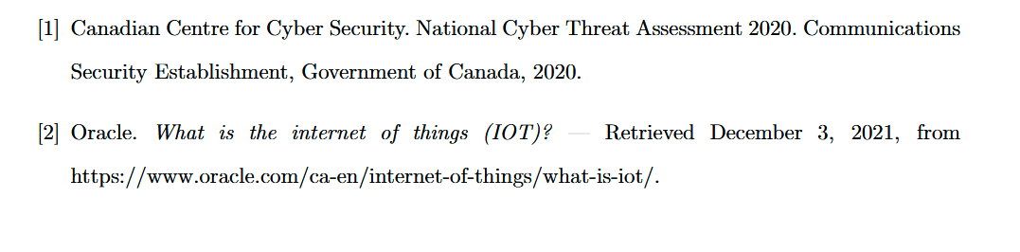
References

